Slide 1
WK6 – Self-Organising Networks
CS 476: Networks of Neural Computation
WK6 – Self-Organising Networks:
Dr. Stathis Kasderidis
Dept. of Computer Science
University of Crete
Spring Semester, 2009

Slide 2
Contents
Introduction
Self-Organising Map model
Properties of SOM
Examples
Learning Vector Quantisation
Conclusions
Contents

Slide 3
Introduction
We will present a special class of NN which is called a self-organising map.
Their main characteristics are:
  There is competitive learning among the neurons of the output layer (i.e. on the presentation of an input pattern only one neuron wins the competition – this is called a winner);
  The neurons are placed in a lattice, usually 2D;
  The neurons are selectively tuned to various input patterns;
Introduction

Slide 4
Introduction-1
  The locations of the neurons so tuned become ordered with respect to each other in such a way that a meaningful coordinate system for different input features is created over the lattice.
In summary: A self-organising map is characterised by the formation of a topographic map of the input patterns in which the spatial locations (i.e. coordinates) of the neurons in the lattice are indicative of intrinsic statistical features contained in the input patterns.
Introduction

Slide 5
Introduction-2
The motivation for the development of this model is due to the existence of topologically ordered computational maps in the human brain.
A computational map is defined by an array of neurons representing slightly differently tuned processors, which operate on the sensory information signals in parallel.
Consequently, the neurons transform input signals into a place-coded probability distribution that represents the computed values of parameters by sites of maximum relative activity within the map.
Introduction

Slide 6
Introduction-3
There are two different models for the self-organising map:
  Willshaw-von der Malsburg model;
  Kohonen model.
In both models the output neurons are placed in a 2D lattice.
They differ in the way input is given:
  In the Willshaw-von der Malsburg model the input is also a 2D lattice of equal number of neurons;
  In the Kohonen model there isn’t any input lattice, but an array of input neurons
Introduction

Slide 7
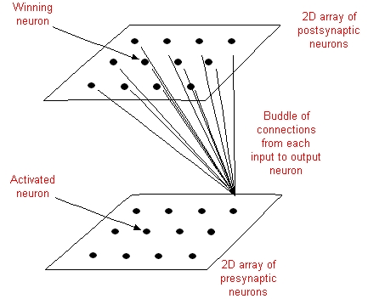
Introduction-4
Schematically the models are shown below:
Introduction
Willshaw – von der Malsburg model

Slide 8
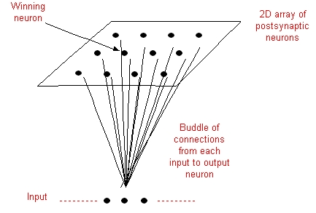
Introduction-5
Introduction
Kohonen model

Slide 9
Introduction-6
The model of Willshaw & von der Malsburg was proposed as an effort to explain the retinotopic mapping from the retina to the visual cortex.
Two layers of neurons with each input neuron fully connected to the output neurons layer.
The output neurons have connections of two types among them:
  Short-range excitatory ones
  Long-range inhibitory ones
  Connection from input → output are modifiable and are of Hebbian type
Introduction

Slide 10
Introduction-7
The total weight associated with a postsynaptic neuron is bounded. As a result some incoming connections are increased while others decrease. This is needed in order to achieve stability of the network due to ever-increasing values of synaptic weights.
The number of input neurons is the same as the number of the output neurons.
Introduction

Slide 11
Introduction-8
The Kohonen model is a more general version of the Willshaw-von der Malsburg model.
It allows for compression of information. It belongs to a class of vector-coding algorithms. I.e. it provides a topological mapping that optimally places a fixed number of vectors into a higher-dimensional space and thereby facilitates data compression.
Introduction

Slide 12
Self-Organising Map
The main goal of the SOM is to transform an incoming pattern of arbitrary dimension into a one- or two- dimensional discrete map, and to perform this transformation adaptively in a topologically ordered fashion.
Each output neuron is fully connected to all the source nodes in the input layer.
This network represents a feedforward structure with a single computational layer consisting of neurons arranged in a 2D or 1D grid. Higher dimensions > 2D are possible but not used very often. Grid topology can be square, hexagonal, etc.
SOM

Slide 13
Self-Organising Map-1
An input pattern to the SOM network represents a localised region of “activity” against a quiet background.
The location and nature of such a “spot” usually varies from one input pattern to another. All the neurons in the network should therefore be exposed to a sufficient number of different realisations of the input signal in order to ensure that the self-organisation process has the chance to mature properly.
SOM

Slide 14
Self-Organising Map-2
The algorithm which is responsible for the self-organisation of the network is based on three complimentary processes:
  Competition;
  Cooperation;
  Synaptic Adaptation.
We will examine next the details of each mechanism.
SOM

Slide 15
Self-Organising Map-3: Competitive Process
Let m be the dimension of the input space. A pattern chosen randomly from input space is denoted by:
x=[x₁, x₂,…, x_{m}]^{T}
The synaptic weight of each neuron in the output layer has the same dimension as the input space. We denote the weight of neuron j as:
w_{j}=[w_{j1}, w_{j2},…, w_{jm}]^{T}, j=1,2,…,l
Where l is the total number of neurons in the output layer.
To find the best match of the input vector x with the synaptic weights w_{j} we use the Euclidean distance. The neuron with the smallest distance is called i(x) and is given by:
SOM

Slide 16
Self-Organising Map-4: Competitive Process
i(x)=arg min_{j} ||x – w_{j}||, j=1,2,…,l
The neuron (i) that satisfies the above condition is called best-matching or winning neuron for the input vector x.
The above equation leads to the following observation: A continuous input space of activation patterns is mapped onto a discrete output space of neurons by a process of competition among the neurons in the network.
Depending on the application’s interest the response of the network is either the index of the winner (i.e. coordinates in the lattice) or the synaptic weight
SOM

Slide 17
Self-Organising Map-5: Cooperative Process
vector that is closest to the input vector.
The winning neuron effectively locates the center of a topological neighbourhood.
From neurobiology we know that a winning neuron excites more than average the neurons that exist in its immediate neighbourhood and inhibits more the neurons that they are in longer distances.
Thus we see that the neighbourhood should be a decreasing function of the lateral distance between the neurons.
In the neighbourhood are included only excited neurons, while inhibited neurons exist outside of the neighbourhood.
SOM

Slide 18
Self-Organising Map-6: Cooperative Process
If d_{ij} is the lateral distance between neurons i and j (assuming that i is the winner and it is located in the centre of the neighbourhood) and we denote h_{ji} the topological neighbourhood around neuron i, then h_{ji} is a unimodal function of distance which satisfies the following two requirements:
  The topological neighbourhood h_{ji} is symmetric about the maximum point defined by d_{ij}=0; in other words, it attains its maximum value at the winning neuron i for which the distance is zero.
  The amplitude of the topological neighbourhood h_{ji} decreases monotonically with increasing lateral distance d_{ij} decaying to zero for d_{ij} → ∞ ; this is a necessary condition for convergence.
SOM

Slide 19
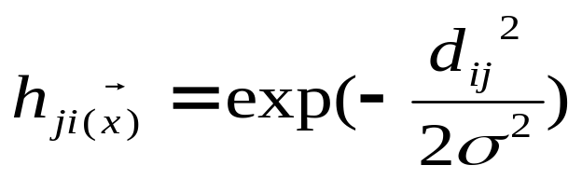
Self-Organising Map-7: Cooperative Process
A typical choice of h_{ji} is the Gaussian function which is translation invariant (i.e. independent of the location of the winning neuron):
The parameter σ is the “effective width” of the neighbourhood. It measures the degree to which excited neurons in the vicinity of the winning neuron participate in the learning process.
SOM

Slide 20
Self-Organising Map-8: Cooperative Process
The distance among neurons is defined as the Euclidean metric. For example for a 2D lattice we have:
d_{ij}² ⁼||r_{j} – r_{i}||²
Where the discrete vector r_{j} defines the position of excited neuron j and r_{i} defines the position of the winning neuron in the lattice.
Another characteristic feature of the SOM algorithm is that the size of the neighbourhood shrinks with time. This requirement is satisfied by making the width of the Gaussian function decreasing with time.
SOM

Slide 21
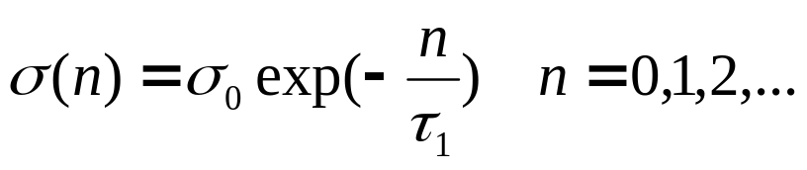
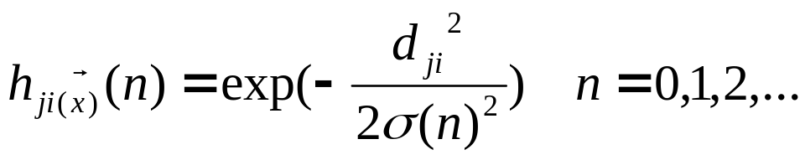
Self-Organising Map-9: Cooperative Process
A popular choice is the exponential decay described by:
Where σ₀ is the value of σ at the initialisation of the SOM algorithm and τ₁ is a time constant.
Correspondingly the neighbourhood function assumes a time dependent form of its own:
Thus as time increases (i.e. iterations) the width decreases in an exponential manner and the neighbourhood shrinks appropriately.
SOM

Slide 22
Self-Organising Map-10: Adaptive Process
The adaptive process modifies the weights of the network so as to achieve the self-organisation of the network.
Only the winning neuron and neurons inside its neighbourhood have their weights adapted. All the other neurons have no change in their weights.
A method for deriving the weight update equations for the SOM model is based on a modified form of Hebbian learning. There is a forgetting term in the standard Hebbian weight equations.
Let us assume that the forgetting term has the form g(y_{j})w_{j} where y_{j} is the response of neuron j and g(•) is a positive scalar function of y_{j}.
SOM

Slide 23
Self-Organising Map-11: Adaptive Process
The only requirement for the function g(y_{j}) is that the constant term in its Taylor series expansion to be zero when the activity is zero, i.e.:
g(y_{j})=0 for y_{j}=0
The modified Hebbian rule for the weights of the output neurons is given by:
Δw_{j} = η y_{j} x - g(y_{j}) w_{j}
Where η is the learning rate parameter of the algorithm.
To satisfy the requirement for a zero constant term in the Taylor series we choose the following form for the function g(y_{j}):
SOM

Slide 24
Self-Organising Map-12: Adaptive Process
g(y_{j})= η y_{j}
We can simplify further by setting:
y_{j} = h_{ji(x)}
Combining the previous equations we get:
Δw_{j} = η h_{ji(x)} (x – w_{j})
Finally using a discrete representation for time we can write:
w_{j}(n+1) = w_{j}(n) + η(n) h_{ji(x)}(n) (x – w_{j}(n))
The above equation moves the weight vector of the winning neuron (and the rest of the neurons in the neighbourhood) near the input vector x. The rest of the neurons only get a fraction of the correction though.
SOM

Slide 25
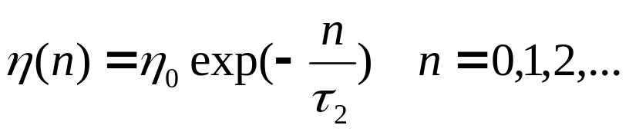
Self-Organising Map-13: Adaptive Process
The algorithm leads to a topological ordering of the feature map in the input space in the sense that neurons that are adjacent in the lattice tend to have similar synaptic weight vectors.
The learning rate must also be time varying as it should be for stochastic approximation. A suitable form is given by:
Where η₀ is an initial value and τ₂ is another time constant of the SOM algorithm.
SOM

Slide 26
Self-Organising Map-14: Adaptive Process
The adaptive process can be decomposed in two phases:
  A self-organising or ordering phase;
  A convergence phase.
We explain next the main characteristics of each phase.
Ordering Phase: It is during this first phase of the adaptive process that the topological ordering of the weight vectors takes place. The ordering phase may take as many as 1000 iterations of the SOM algorithm or more. One should choose carefully the learning rate and the neighbourhood function:
SOM

Slide 27
Self-Organising Map-15: Adaptive Process
  The learning rate should begin with a value close to 0.1; thereafter it should decrease gradually, but remain above 0.01. These requirements are satisfied by making the following choices:
  η₀=0.1, τ₂=1000
  The neighbourhood function should initially include almost all neurons in the network centered on the winning neuron i, and then shrink slowly with time. Specifically during the ordering phase it is allowed to reduce to a small value of couple of neighbours or to the winning neuron itself. Assuming a 2D lattice we may set the σ₀ equal to the “radius” of the lattice. Correspondingly we
SOM

Slide 28
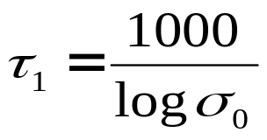
Self-Organising Map-16: Adaptive Process
  may set the time constant τ₁ as:
Convergence phase: This second phase is needed to fine tune the feature map and therefore to provide an accurate statistical quantification of the input space. In general the number of iterations needed for this phase is 500 times the number of neurons in the lattice.
  For good statistical accuracy, the learning parameter must be maintained during this phase to a small value, on the order of 0.01. It should
SOM

Slide 29
Self-Organising Map-17: Adaptive Process
  not allowed to go to zero, otherwise the network may stuck to a metastable state (i.e. a state with a defect);
  The neighbourhood should contain only the nearest neighbours of the winning neuron which may eventually reduce to one or zero neighbouring neurons.
SOM

Slide 30
Self-Organising Map-18: Summary of SOM Algorithm
The basic ingredients of the algorithm are:
  A continuous input space of activation patterns that are generated in accordance with with a certain probability distribution;
  A topology of the network in the form of lattice neurons, which defines a discrete output space;
  A time-varying neighbourhood that is defined around a winning neuron i(x);
  A learning rate parameter that starts at an initial value η₀ and then decreases gradually with time, n, but never goes to zero.
SOM

Slide 31
Self-Organising Map-19: Summary of SOM Algorithm-1
The operation of the algorithm is summarised as follows:
  Initialisation: Choose random values for the initial weight vectors w_{j}(0). The weight vectors must be different for all neurons. Usually we keep the magnitude of the weights small.
  Sampling: Draw a sample x from the input space with a certain probability; the vector x represents the activation pattern that is applied to the lattice. The dimension of x is equal to m.
  Similarity Matching: Find the best-matching (winning) neuron i(x) at time step n by using the minimum Euclidean distance criterion:
SOM

Slide 32
Self-Organising Map-20: Summary of SOM Algorithm-2
i(x)=arg min_{j} ||x – w_{j}||, j=1,2,…,l
  Updating: Adjust the synaptic weight vectors of all neurons by using the update formula:
w_{j}(n+1) = w_{j}(n) + η(n) h_{ji(x)}(n) (x(n) – w_{j}(n))
  Where η(n) is the learning rate and h_{ji(x)}(n) is the neighbourhood function around the winner neuron i(x); both η(n) and h_{ji(x)}(n) are varied dynamically for best results.
  Continuation: Continue with step 2 until no noticeable changes in the feature map are observed.
SOM

Slide 33
Properties
Here we summarise some useful properties of the SOM model:
  Pr1 - Approximation of the Input Space: The feature map Φ, represented by the set of synaptic weight vectors {w_{j}} in the output space A, provides a good approximation to the input space H.
  Pr2 – Topological Ordering: The feature map Φ computed by the SOM algorithm is topologically ordered in the sense that the spatial location of a neuron in the lattice corresponds to a particular domain or feature of the input patterns.
  Pr3 – Density Matching: The feature map Φ reflects variations in the statistics of the input distribution: regions in the input space H from which sample vectors
Properties

Slide 34
Properties-1
  x are drawn with a high probability of occurrence are mapped onto larger domains of the output space A, and therefore with better resolution than regions in H from which sample vectors x are drawn with a low probability of occurrence.
  Pr4 – Feature Selection: Given data from an input space with a nonlinear distribution, the self-organising map is able to select a set of best features for approximating the underlying distribution.
Properties

Slide 35
Examples
We present two examples in order to demonstrate the use of the SOM model:
  Colour Clustering;
  Semantic Maps.
Colour Clustering: In the first example a number of images is given which contain a set of colours which are found in a natural scene. We seek to cluster the colours found in the various images.
We select a network with 3 input neurons (representing the RGB values of a single pixel) and an output 2D layer consisting of 40x40 neurons arranged in a square lattice. We use 4M pixels to train the
Examples

Slide 36
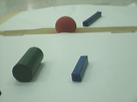
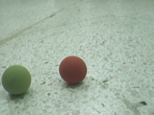
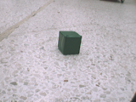
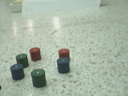




Examples-1
network. We use a fixed learning rate of η=1.0E-4 and 1000 epochs. About 200 images were used in order to extract the pixel values for training.
Some of the original images and unsuccessful & successful colour maps are shown below:
Examples

Slide 37
Examples-2
Semantic Maps: A useful method of visualisation of the SOM structure achieved at the end of training assigns class labels in a 2D lattice depending on how each test pattern (not seen before) excites a particular neuron.
The neurons in the lattice are partitioned to a number of coherent regions, coherent in the sense that each grouping of neurons represents a distinct set of contiguous symbols or labels.
An example is shown below, where we assume that we have trained the map for 16 different animals.
We use a lattice of 10x10 output neurons.
Examples

Slide 38
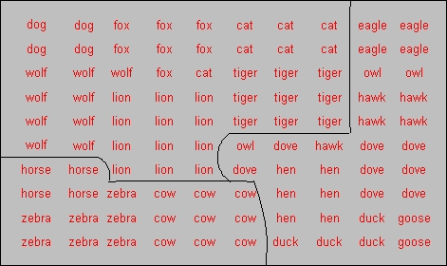
Examples-3
We observe that there are three distinct clusters of animals: “birds”, “peaceful species” and “hunters”.
Examples

Slide 39
LVQ
Vector Quantisation is a technique that exploits the underlying structure of input vectors for the purpose of data compression.
An input space is divided in a number of distinct regions and for each region a reconstruction (representative) is defined.
When the quantizer is presented with a new input vector, the region in which the vector lies is first determined, and is then represented by the reproduction vector for this region.
The collection of all possible reproduction vectors is called the code book of the quantizer and its members are called code words.
LVQ

Slide 40
LVQ-1
A vector quantizer with minimum encoding distortion is called Voronoi or nearest-neighbour quantizer, since the Voronoi cells about a set of points in an input space correspond to a partition of that space according to the nearest-neighbour rule based on the Euclidean metric.
An example with an input space divided to four cells and their associated Voronoi vectors is shown below:
LVQ

Slide 41
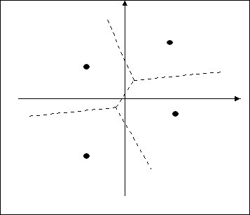
LVQ-2
The SOM algorithm provides an approximate method for computing the Voronoi vectors in an unsupervised manner, with the approximation being specified by the
LVQ

Slide 42
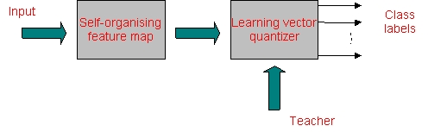
LVQ-3
weight vectors of the neurons in the feature map.
Computation of the feature map can be viewed as the first of two stages for adaptively solving a pattern classification problem as shown below. The second stage is provided by the learning vector quantization, which provides a method for fine tuning of a feature map.
LVQ

Slide 43
LVQ-4
Learning vector quantization (LVQ) is a supervised learning technique that uses class information to move the Voronoi vectors slightly, so as to improve the quality of the classifier decision regions.
An input vector x is picked at random from the input space. If the class labels of the input vector and a Voronoi vector w agree, the Voronoi vector is moved in the direction of the input vector x. If, on the other hand, the class labels of the input vector and the Voronoi vector disagree, the Voronoi vector w is moved away from the input vector x.
Let us denote {w_{j}}_{j=1}^{l} the set of Voronoi vectors, and let {x_{i}}_{i=1}^{N} be the set of input vectors. We assume that
LVQ

Slide 44
LVQ-5
N >> l.
The LVQ algorithm proceeds as follows:
  Suppose that the Voronoi vector w_{c} is the closest to the input vector x_{i}. Let C_{wc} and C_{xi} denote the class labels associated with w_{c} and x_{i} respectively. Then the Voronoi vector w_{c} is adjusted as follows:
    If C_{wc} = C_{xi} then
    W_{c}(n+1)= w_{c}(n)+a_{n}[x_{i}- w_{c}(n)]
    Where 0< a_{n} <1
LVQ

Slide 45
LVQ-6
    If C_{wc} ≠ C_{xi} then
    W_{c}(n+1)= w_{c}(n)-a_{n}[x_{i}- w_{c}(n)]
  The other Voronoi vectors are not modified.
It is desirable for the learning constant a_{n} to decrease monotonically with time n. For example a_{n} could be initially 0.1 and decrease linearly with n.
After several passes through the input data the Voronoi vectors typically converge at which point the training is complete.
LVQ

Slide 46
Conclusions
The SOM model is neurobiologically motivated and it captures the important features contained in an input space of interest.
The SOM is also a vector quantizer.
It supports the form of learning which is called unsupervised in the sense that no target information is given with the presentation of the input.
It can be combined with the method of Leanring Vector Quantization in order to provide a combined supervised learning technique for fine-tuning the Voronoi vectors of a suitable partition of the input space.
Conclusions

Slide 47
Conclusions-1
It is used in multiple applications such as computational neuroscience, finance, language studies, etc.
It can be visualised with two methods:
  The first represents the map as an elastic grid of neurons;
  The second corresponds to the semantic map approach.
Conclusions

